Slide 1

Phylogenetic trees across algorithms
A presentation by Liz Wyman, Kleo Bano, Roberto Rivas, and Chris Troyer

Slide 2
Algorithm differences
UPGMA – Distance-based tree in which distances of leaves with same root are the same.
Neighbor-Joining – Distance-based tree that finds a pair of leaves close to each other and far from other leaves.
Parsimony – Character-based tree that seeks lowest number of mutations possible.

Slide 3
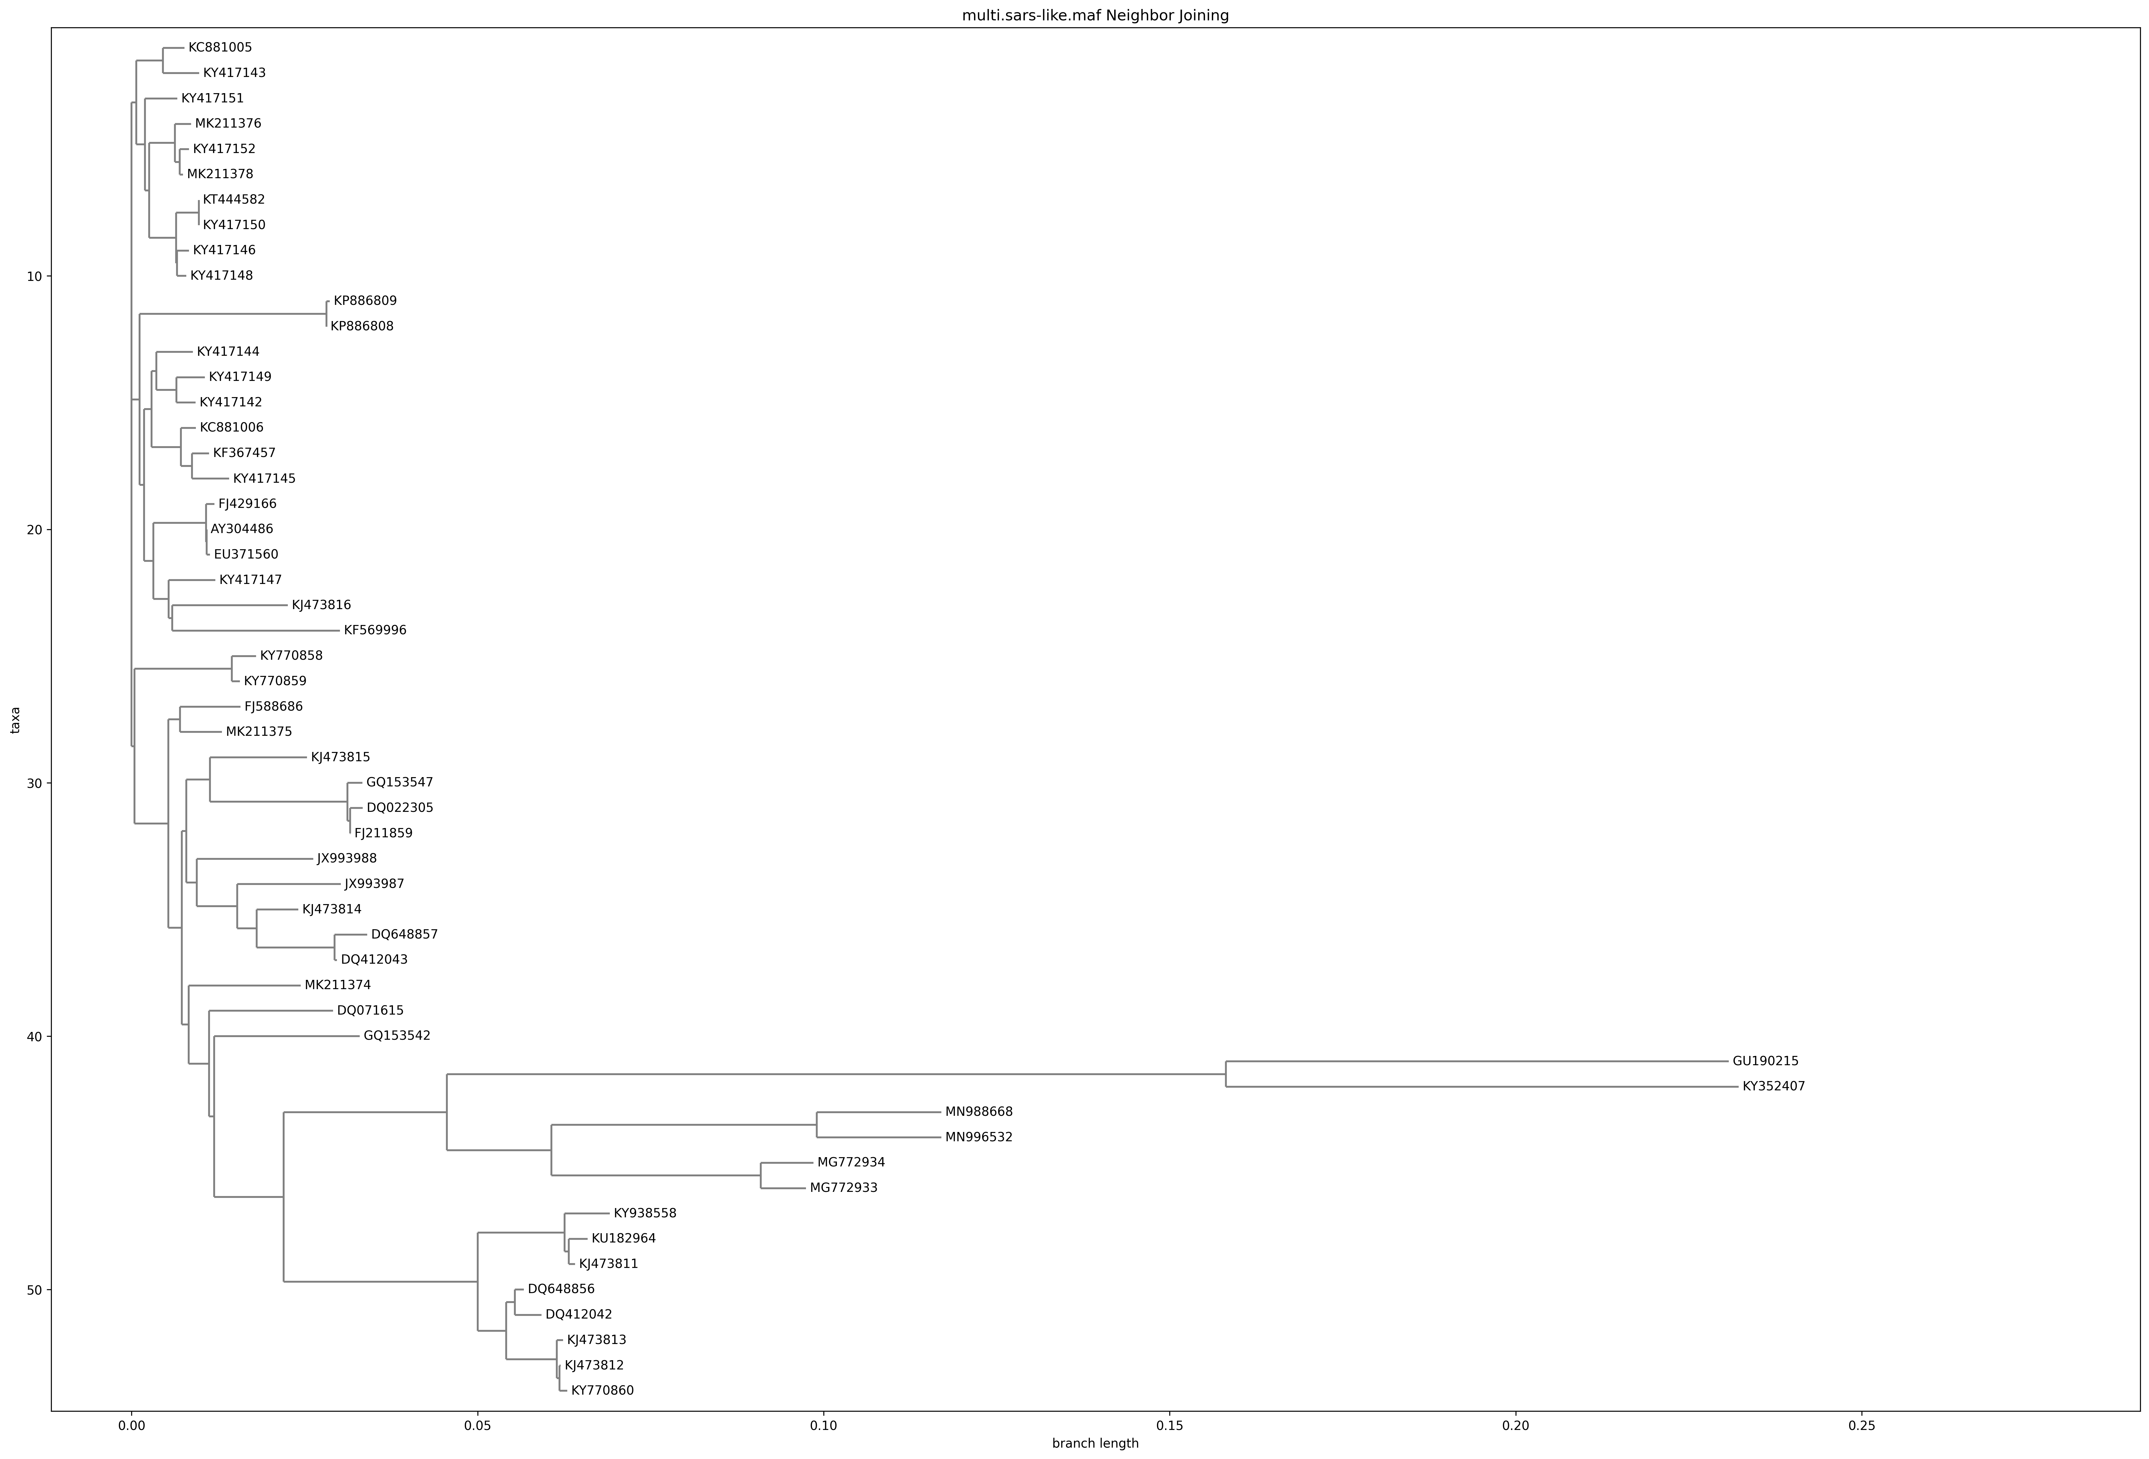
Neighbor joining - multiple SARS strains

Slide 4
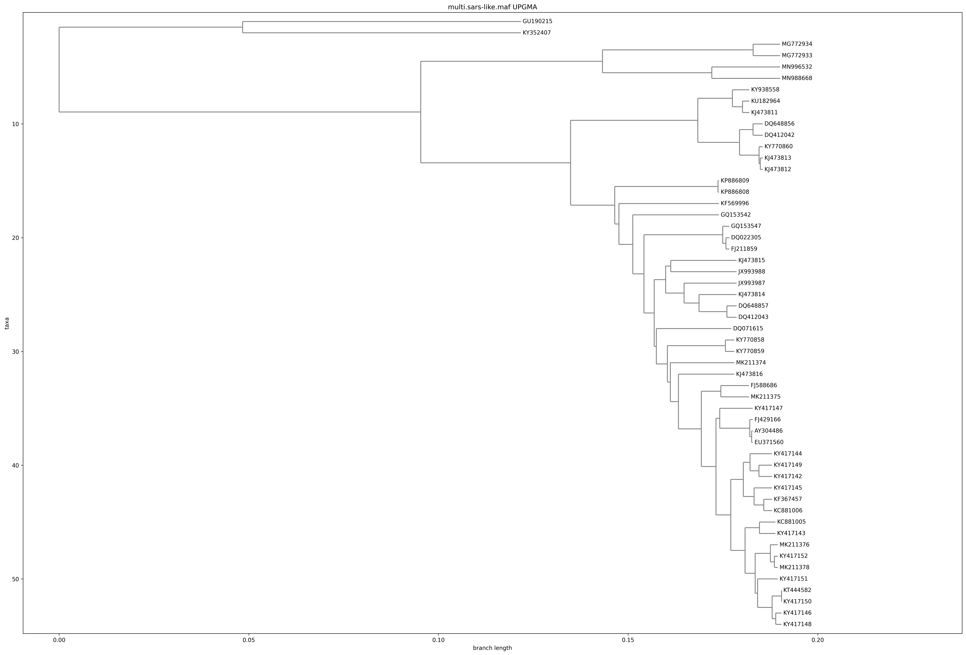
UPGMA – multiple SARS strains

Slide 5
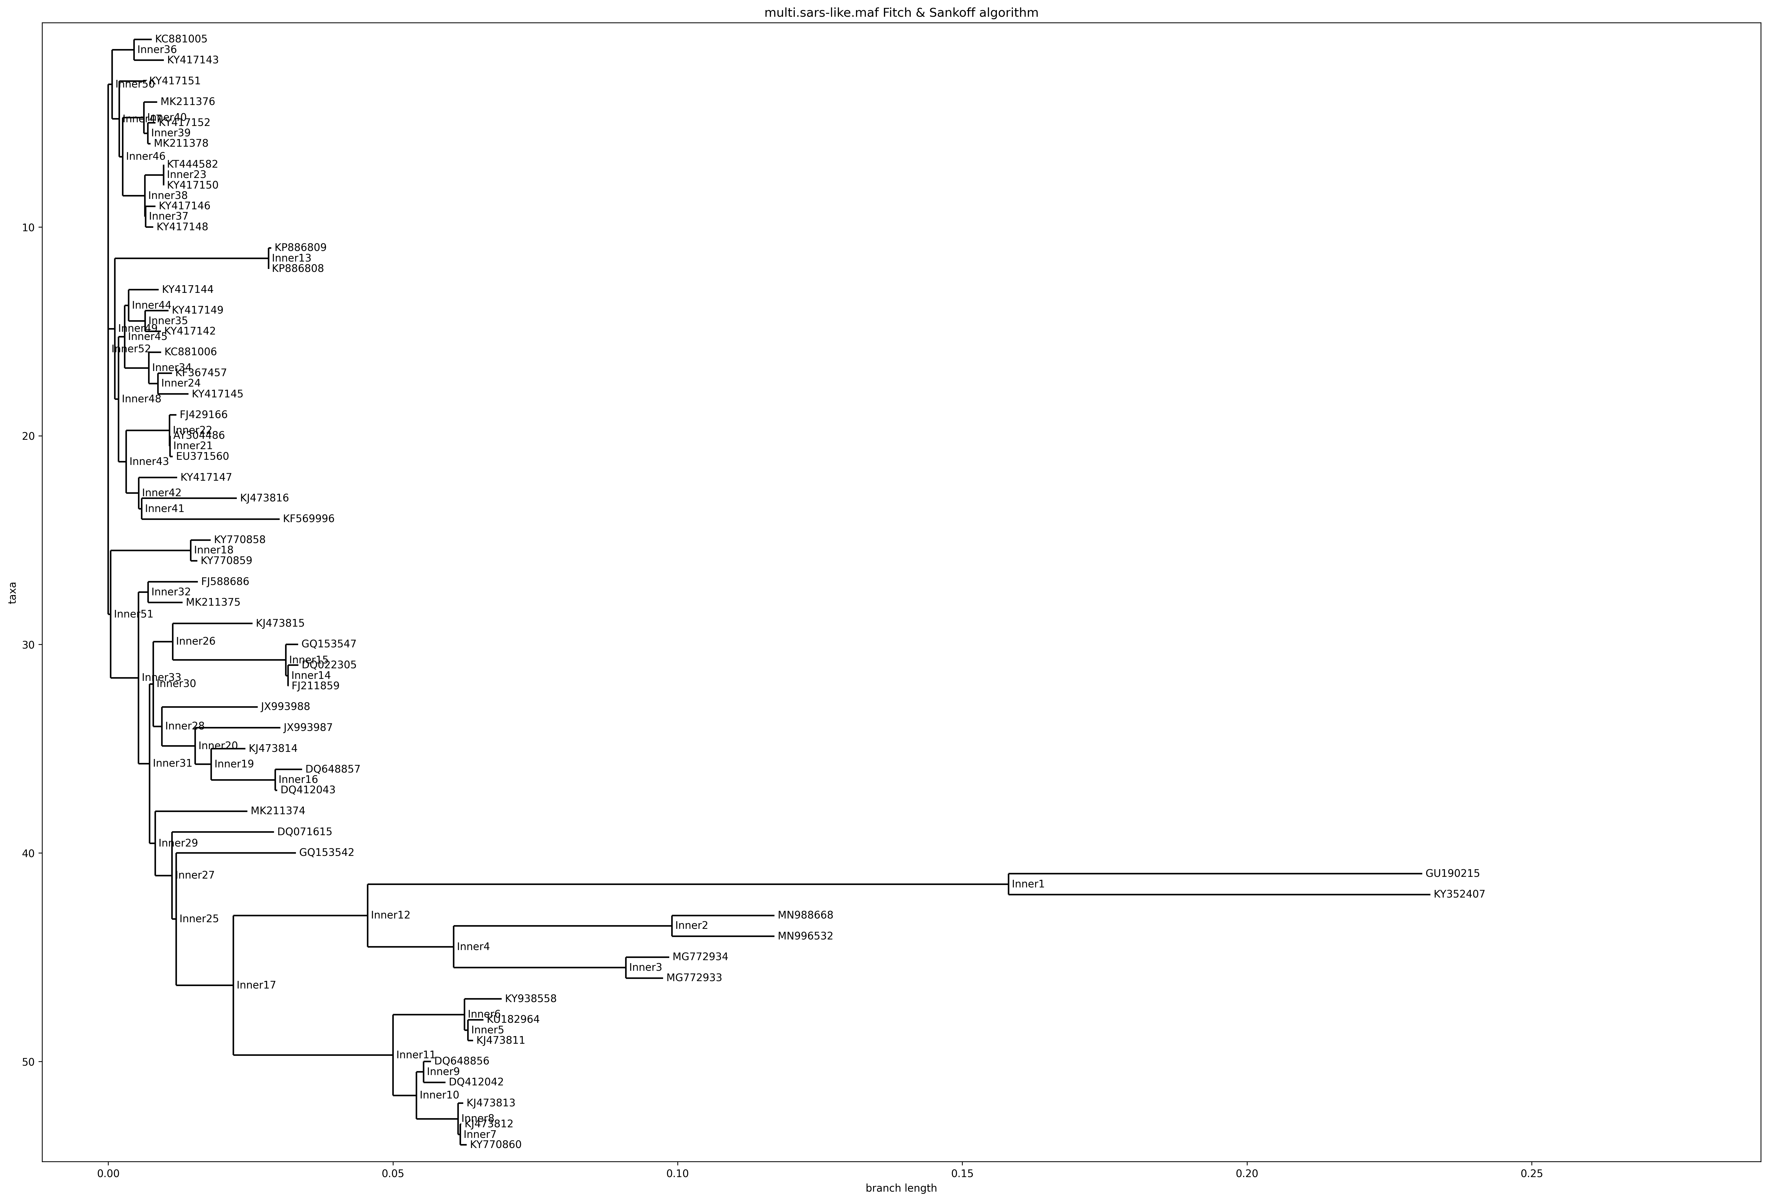
Parsimony – multiple SARS strains

Slide 6
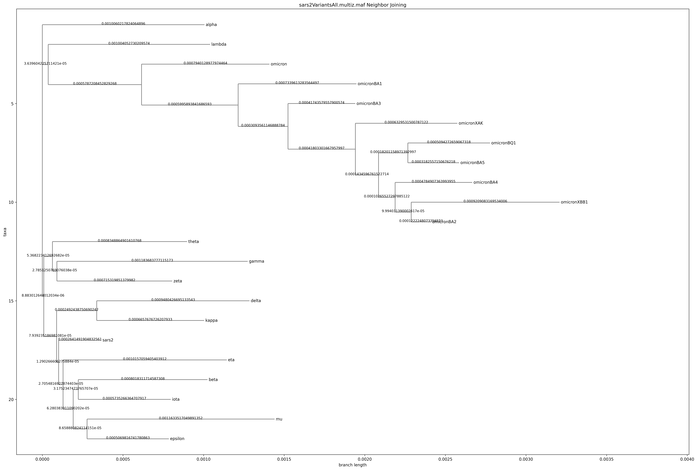
Neighbor joining – SARS-COV-2 variants

Slide 7
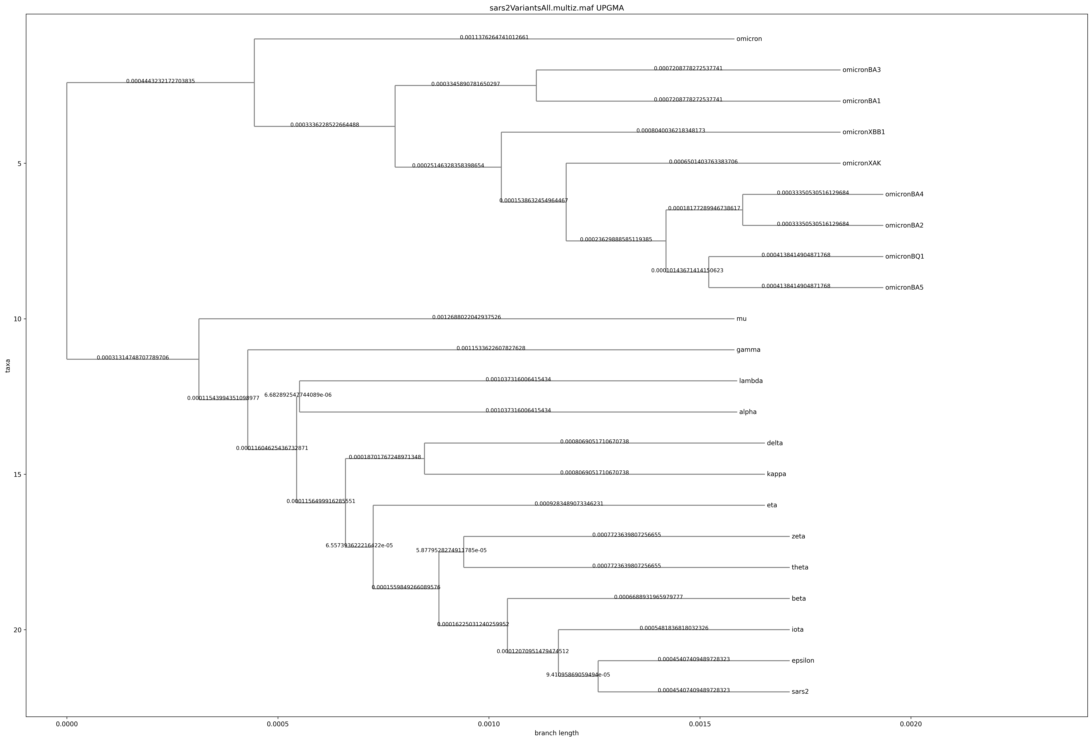
UPGMA – SARS-COV-2 variants

Slide 8

Parsimony – SARS-COV-2 variants

Slide 9
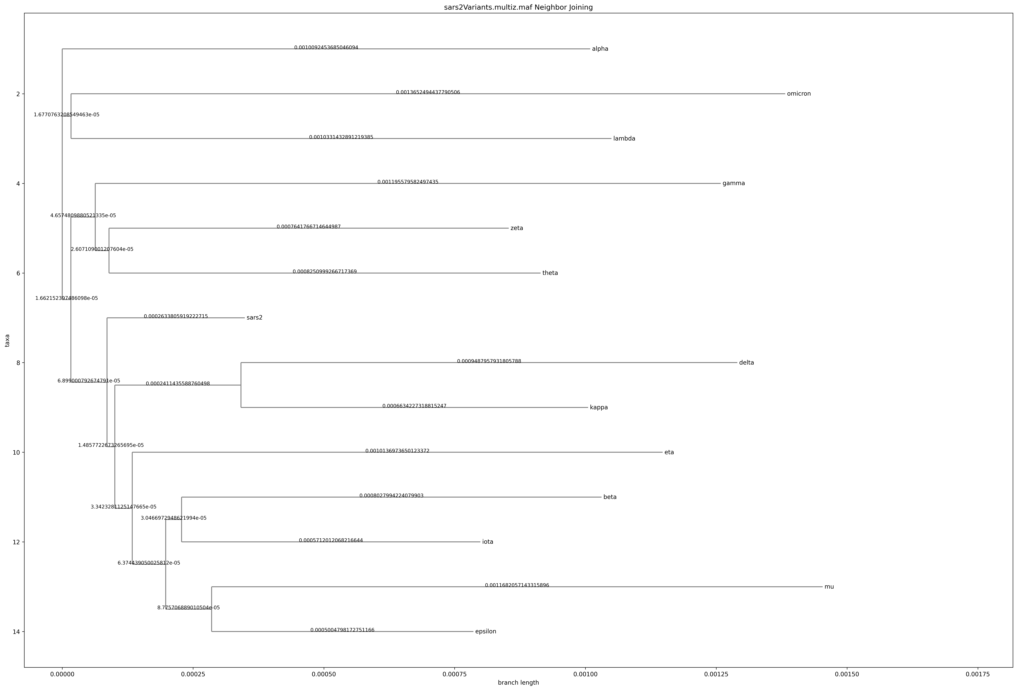
Neighbor joining – SARS-COV-2 variants w/o omicron variants

Slide 10
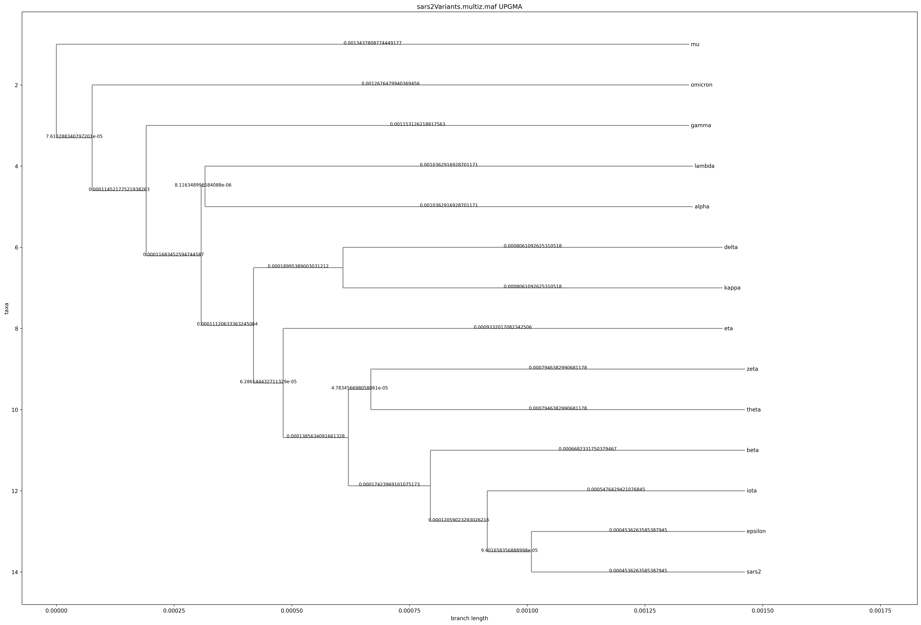
UPGMA– SARS-COV-2 variants w/o omicron variants

Slide 11
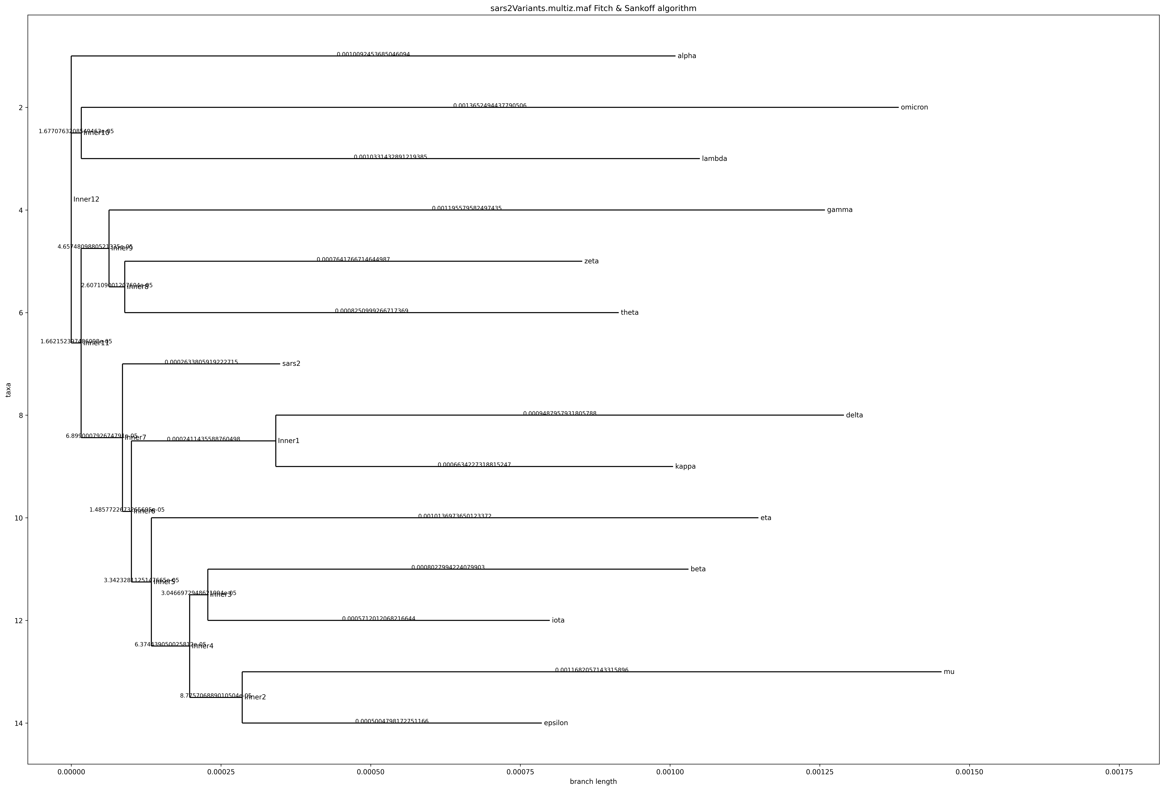
Parsimony – SARS-COV-2 variants w/o omicron variants

Slide 12
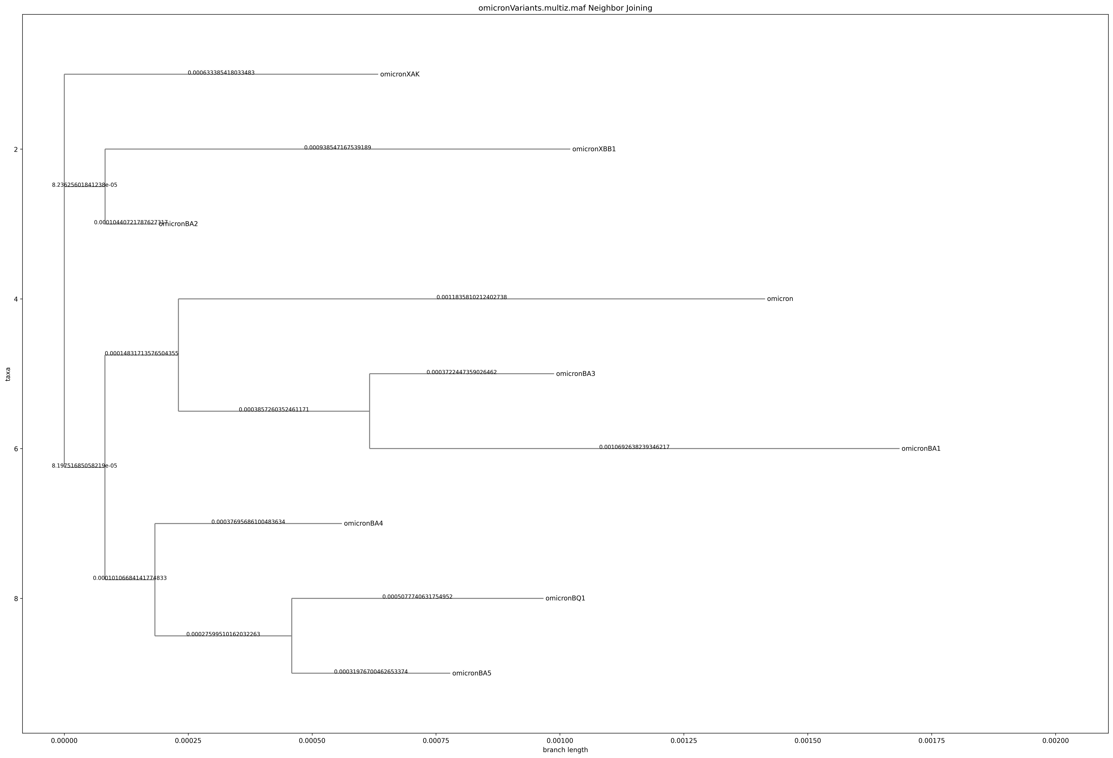
Neighbor joining – omicron variants only

Slide 13
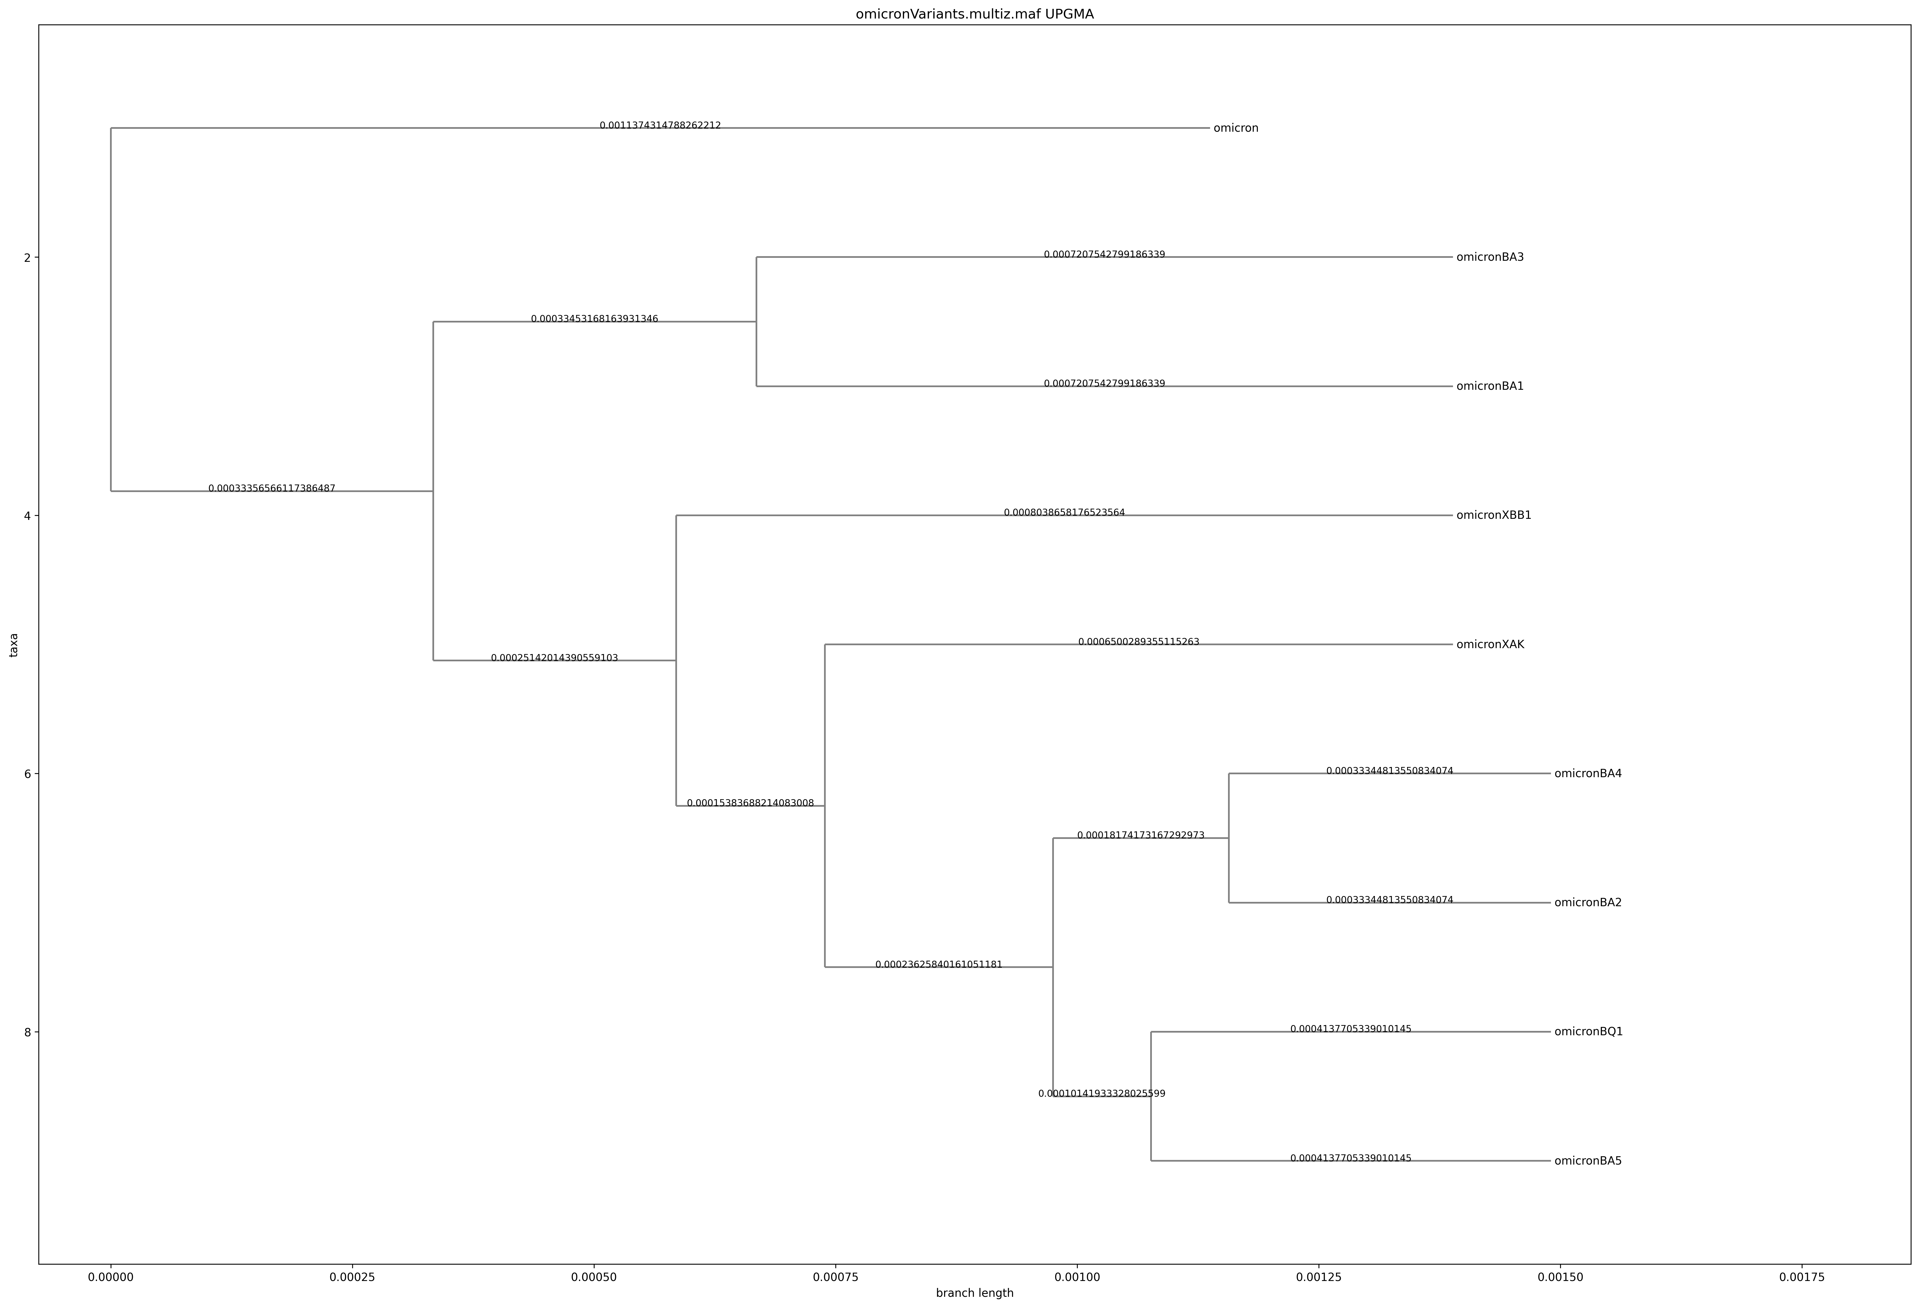
UPGMA – omicron variants only

Slide 14
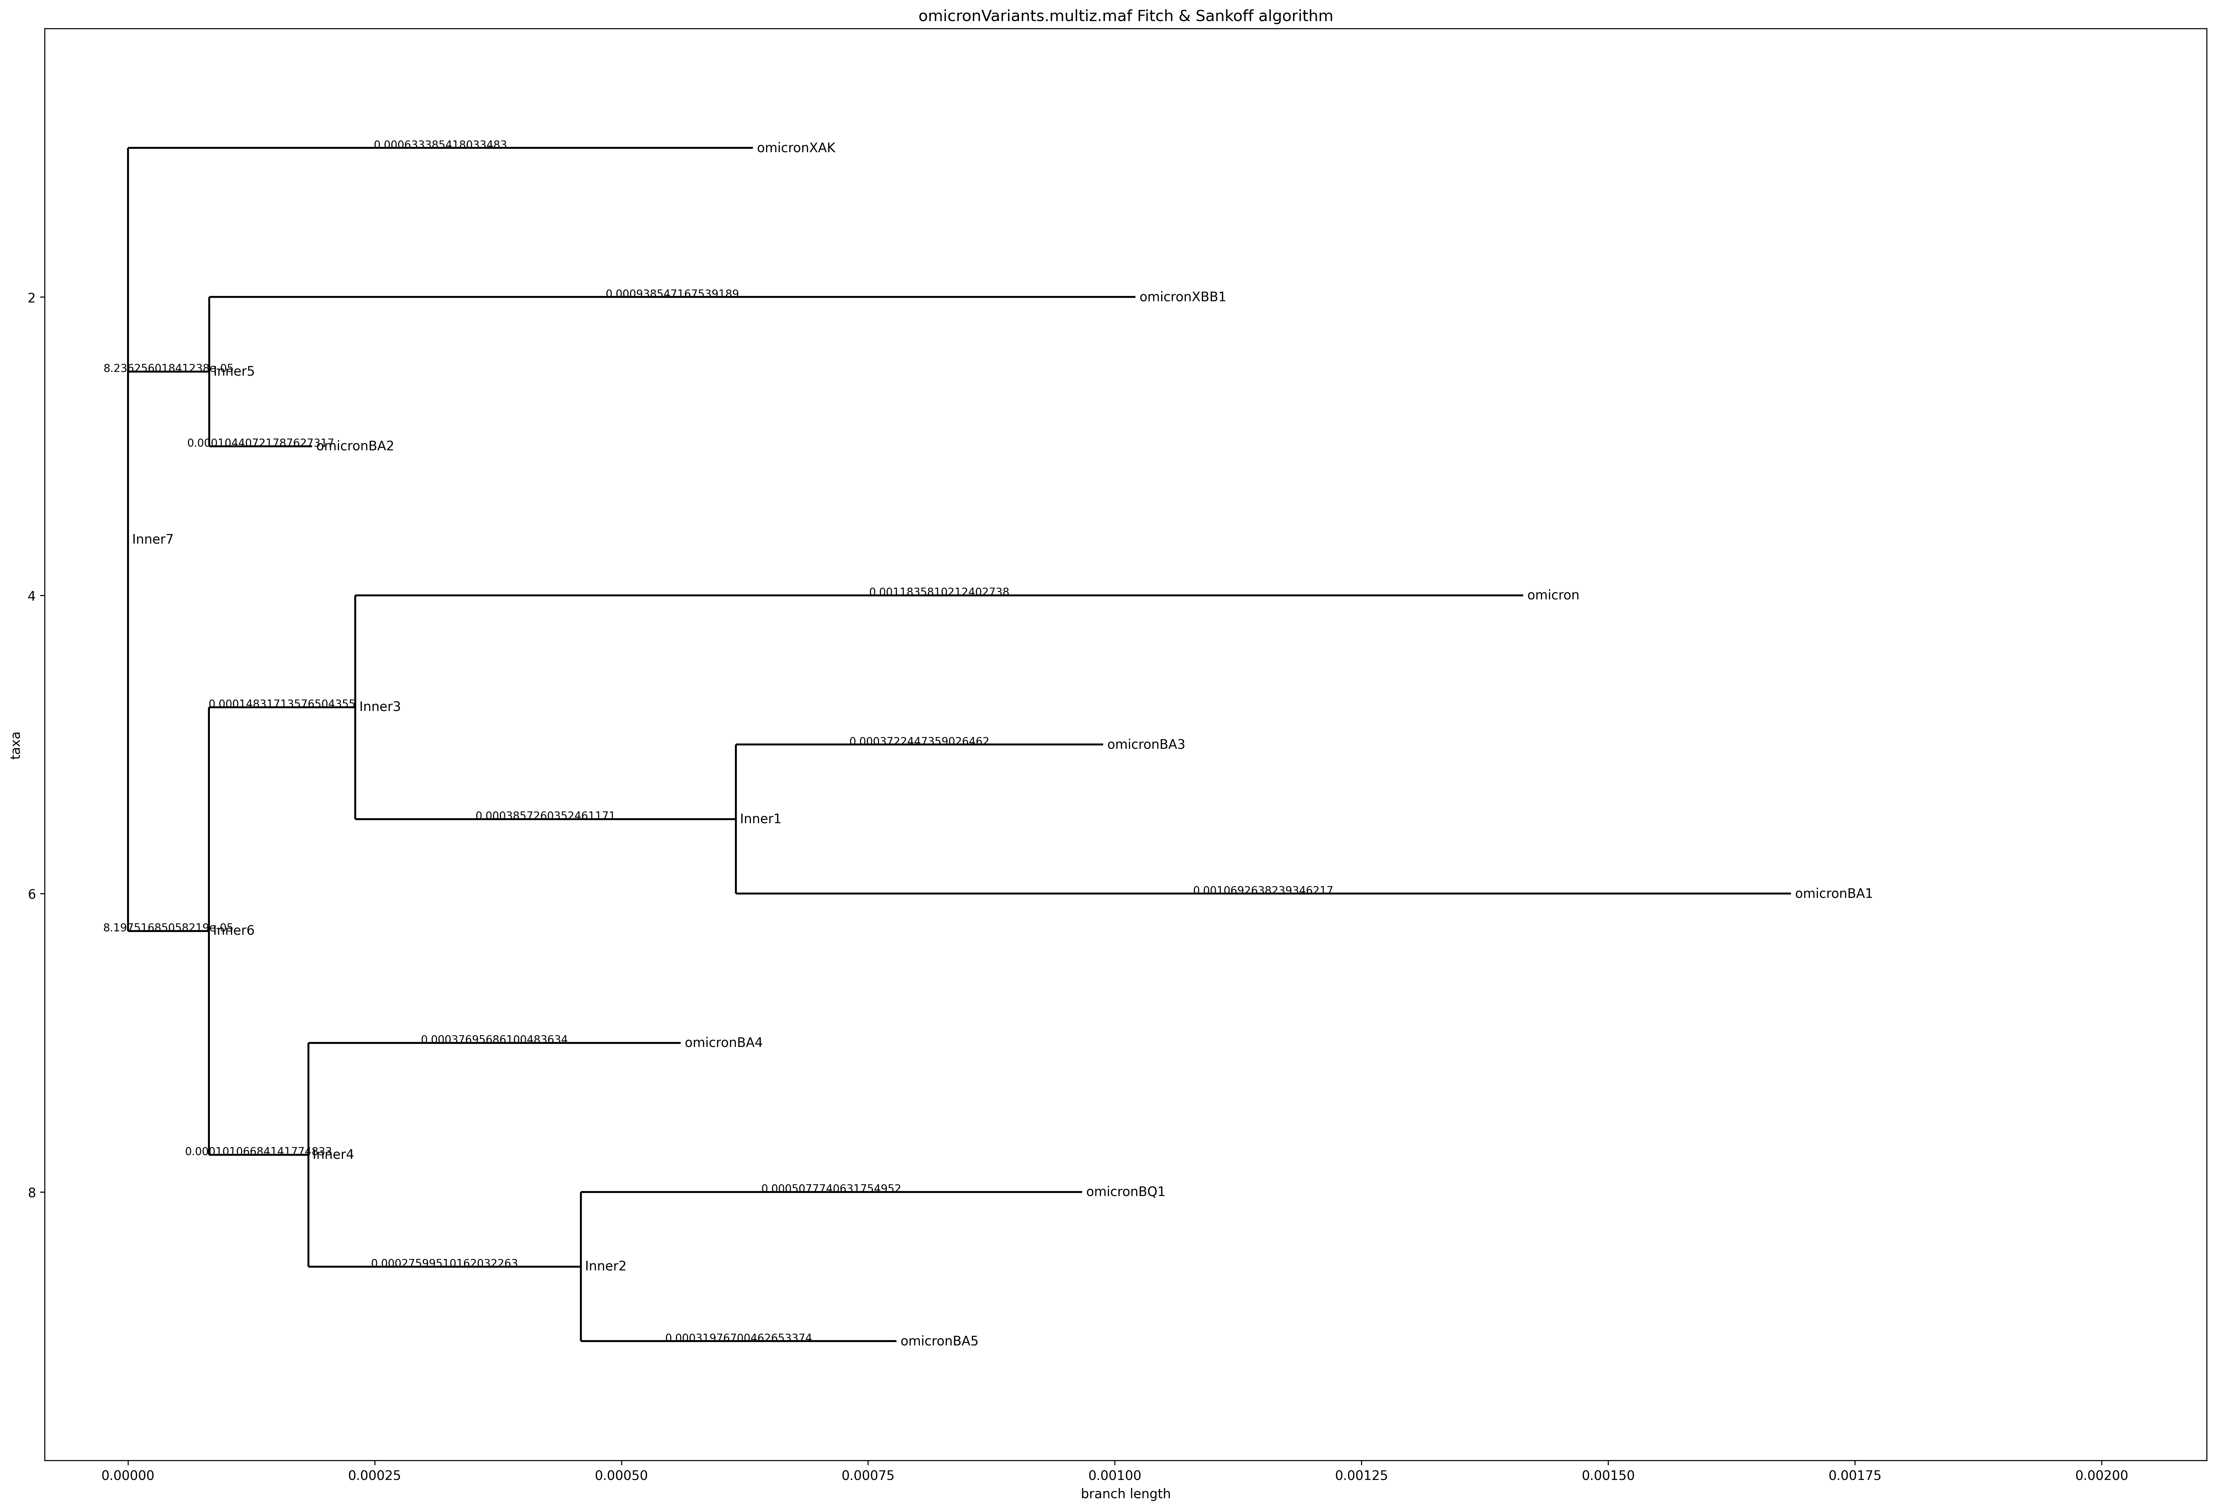
Parsimony – omicron variants only

